Slide 1

Bell Work: Convert from Degrees to Radians or Radians to Degrees
$$380°=$$
$$\frac{15π}{9} rad=$$

Slide 2
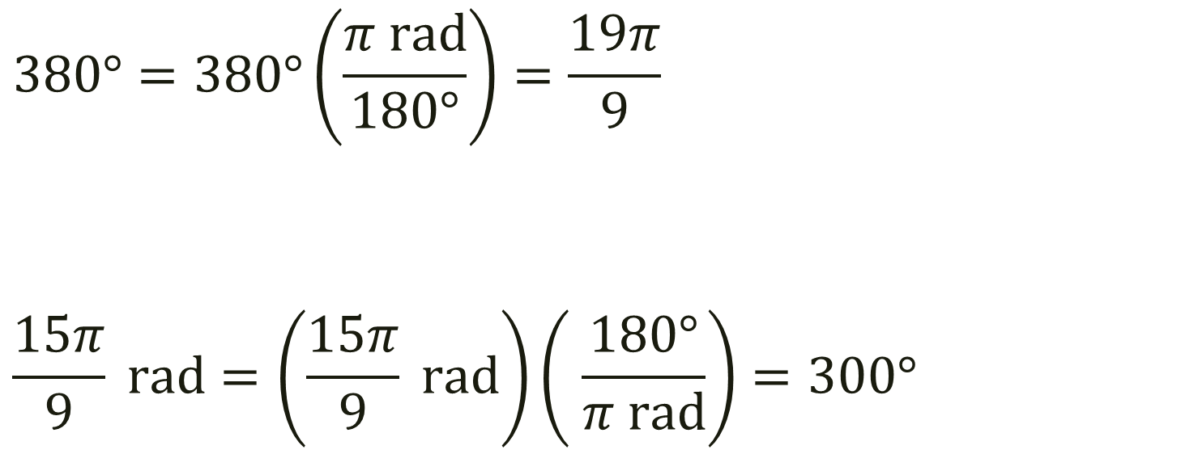
Bell Work: Convert from Degrees to Radians or Radians to Degrees
$$380°=380°\left(\frac{π rad}{180°}\right)=\frac{19π}{9}$$
$$\frac{15π}{9} rad=\left(\frac{15π}{9} rad\right)\left( \frac{180°}{π rad}\right)=300°$$

Slide 3
Pre-calc trig
Day 30

Slide 4
From last time and For Next Time:
Page 288 #17, 23-24, 27, 29, 31 ← Radian #41, 45-46, 49, 51, 53 ← Degree #57-58, 61-62, 65-66, 73-74 ← Convert #89-90, 93-94, 98-99, 109-110, 112, 118-119 ←Applied

Slide 5
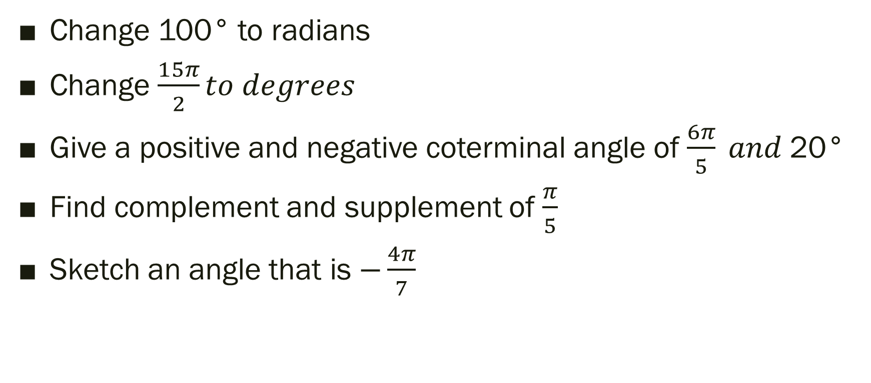
“Practice Test” Level 2 Conversions
Change 100° to radians
Change $\frac{15π}{2}to degrees$
Give a positive and negative coterminal angle of $\frac{6π}{5} and$20°
Find complement and supplement of $\frac{π}{5}$
Sketch an angle that is $−\frac{4π}{7}$

Slide 6
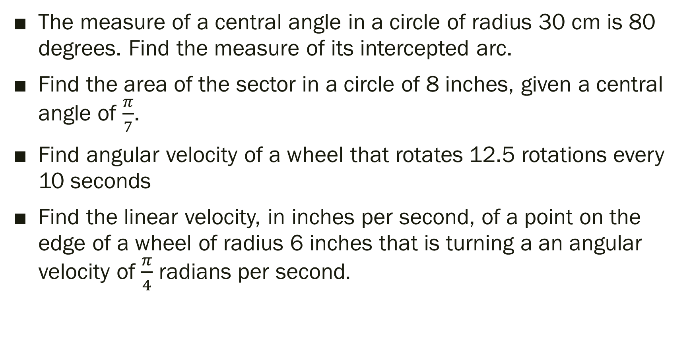
“Practice Test” Level 2 Applied
The measure of a central angle in a circle of radius 30 cm is 80 degrees. Find the measure of its intercepted arc.
Find the area of the sector in a circle of 8 inches, given a central angle of $\frac{π}{7}$.
Find angular velocity of a wheel that rotates 12.5 rotations every 10 seconds
Find the linear velocity, in inches per second, of a point on the edge of a wheel of radius 6 inches that is turning a an angular velocity of $\frac{π}{4}$ radians per second.

Slide 7
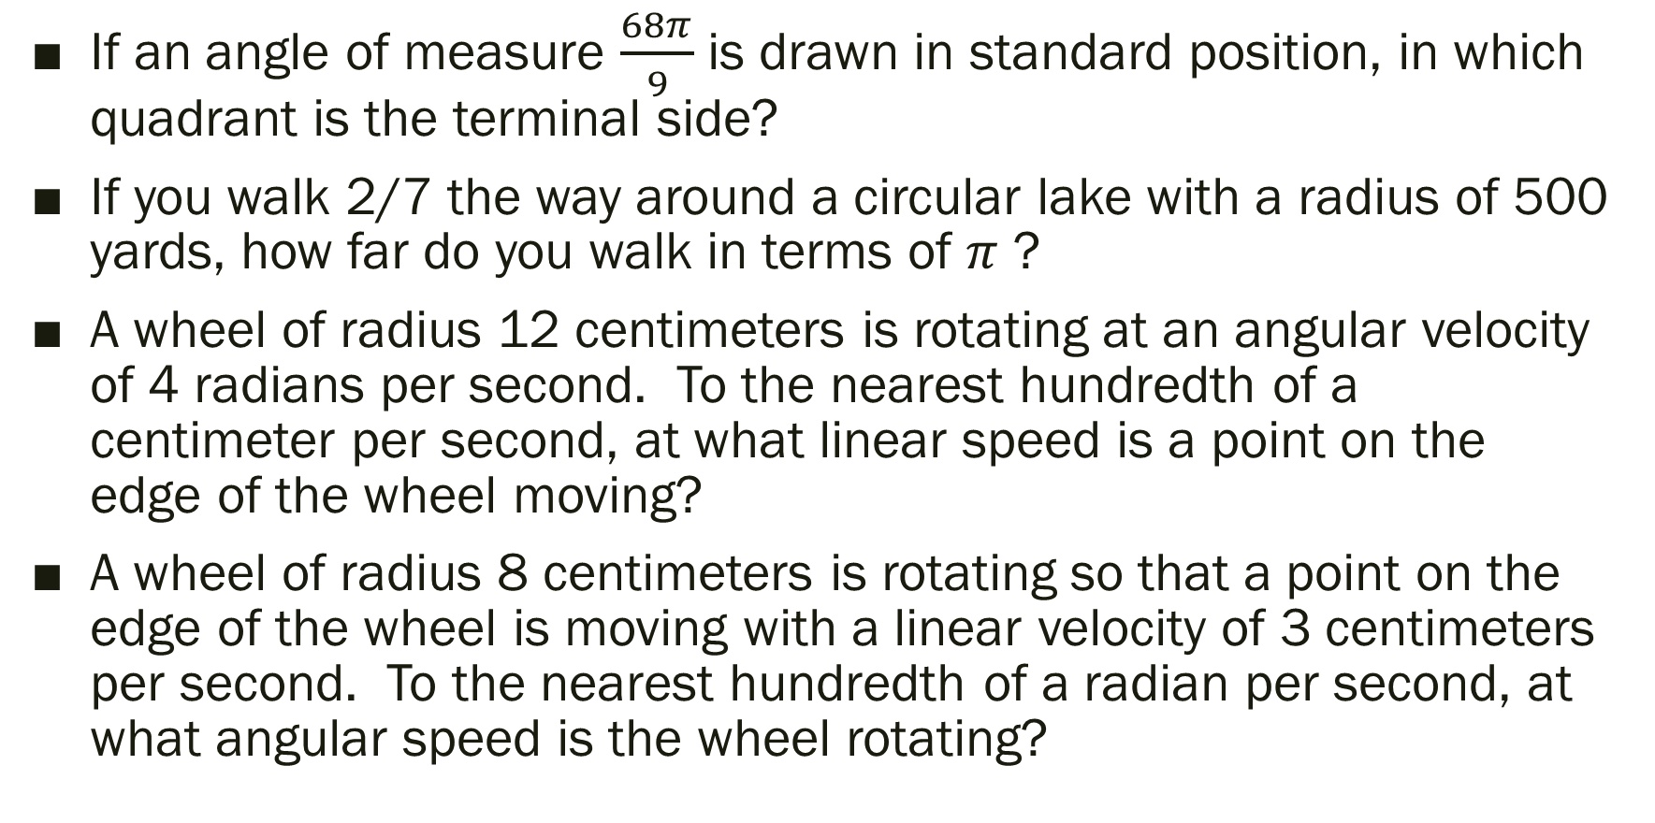
“Practice Test” Level 3
If an angle of measure $\frac{68π}{9}$ is drawn in standard position, in which quadrant is the terminal side?
If you walk 2/7 the way around a circular lake with a radius of 500 yards, how far do you walk in terms of $π$ ?
A wheel of radius 12 centimeters is rotating at an angular velocity of 4 radians per second. To the nearest hundredth of a centimeter per second, at what linear speed is a point on the edge of the wheel moving?
A wheel of radius 8 centimeters is rotating so that a point on the edge of the wheel is moving with a linear velocity of 3 centimeters per second. To the nearest hundredth of a radian per second, at what angular speed is the wheel rotating?

Slide 8
“Practice Test” Level 4
At what angular velocity, in radians per second, should the wheels on a bike with 32-inch diameter wheels be turning so that the bike is traveling at 15 miles per hour? (to the nearest hundredth)
Note: (5280 feet =1 mile, 60 minutes=1 hour, 60 seconds=1 minute)

Slide 9
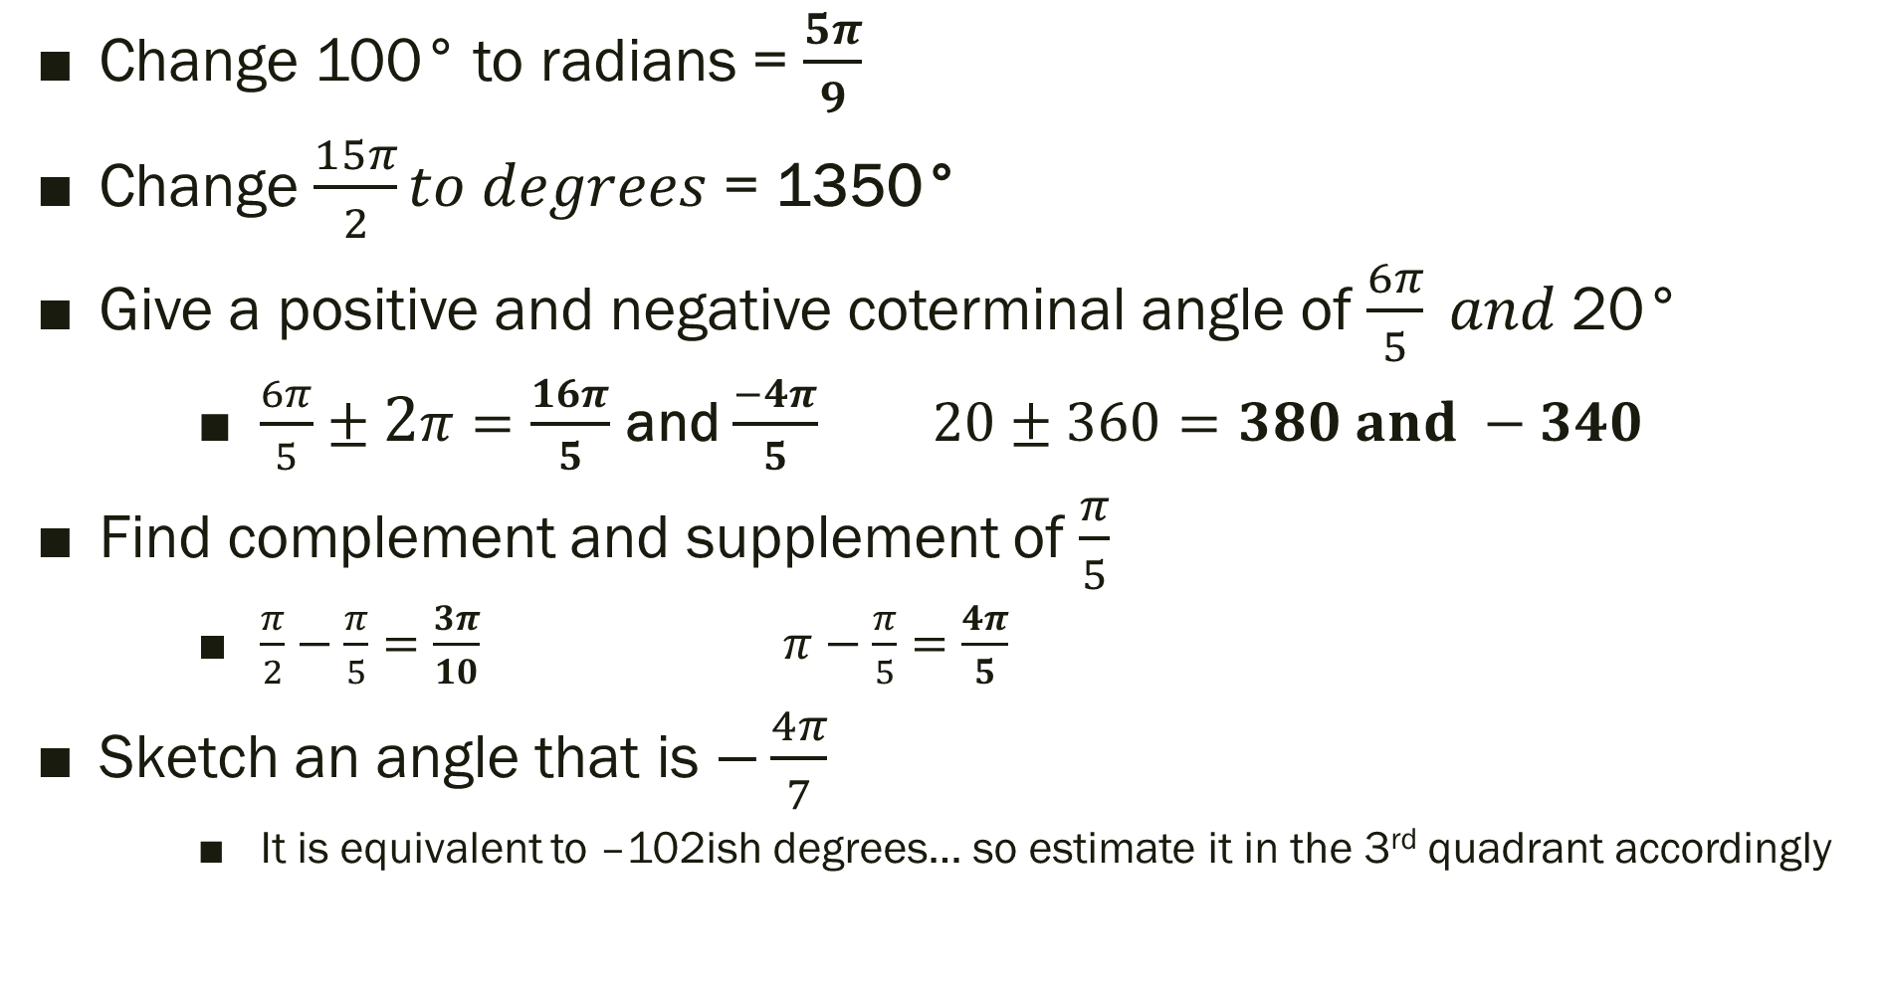
“Practice Test” Level 2 Conversions SOLUTIONS
Change 100° to radians = $\frac{5π}{9}$
Change $\frac{15π}{2}to degrees$ = 1350°
Give a positive and negative coterminal angle of $\frac{6π}{5} and$20°
$\frac{6π}{5}±2π=\frac{16π}{5}$ and $\frac{−4π}{5}$ $20±360=380 and −340$
Find complement and supplement of $\frac{π}{5}$
$\frac{π}{2}−\frac{π}{5}=\frac{3π}{10}$ $π−\frac{π}{5}=\frac{4π}{5}$
Sketch an angle that is $−\frac{4π}{7}$
It is equivalent to –102ish degrees… so estimate it in the 3rd quadrant accordingly

Slide 10
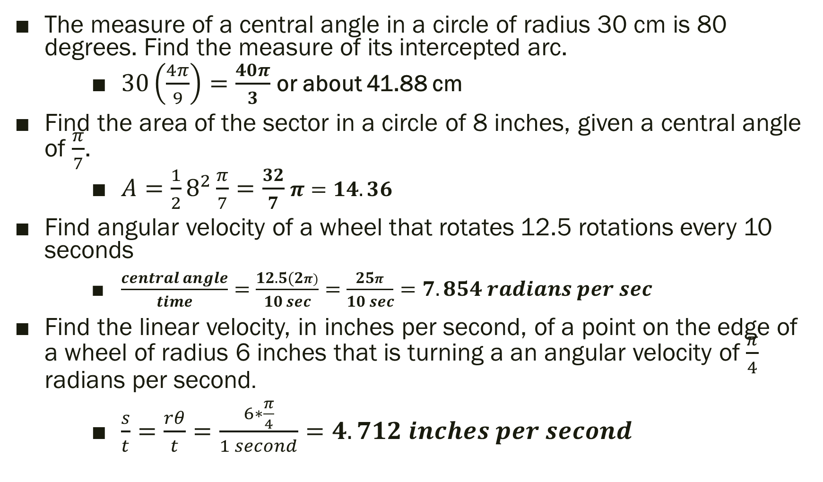
“Practice Test” Level 2 Applied SOLUTION
The measure of a central angle in a circle of radius 30 cm is 80 degrees. Find the measure of its intercepted arc.
$30\left(\frac{4π}{9}\right)=\frac{40π}{3}$ or about 41.88 cm
Find the area of the sector in a circle of 8 inches, given a central angle of $\frac{π}{7}$.
$A=\frac{1}{2}8^{2}\frac{π}{7}=\frac{32}{7}$ $π=14.36$
Find angular velocity of a wheel that rotates 12.5 rotations every 10 seconds
$\frac{central angle}{time}=\frac{12.5(2π)}{10 sec}=\frac{25π}{10 sec}=7.854 radians per sec$
Find the linear velocity, in inches per second, of a point on the edge of a wheel of radius 6 inches that is turning a an angular velocity of $\frac{π}{4}$ radians per second.
$\frac{s}{t}=\frac{rθ}{t}=\frac{6∗\frac{π}{4}}{1 second}=4.712 inches per second$

Slide 11
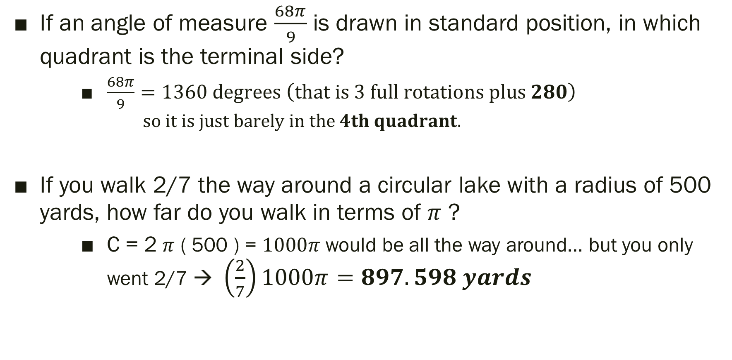
“Practice Test” Level 3 SOLUTIONS
If an angle of measure $\frac{68π}{9}$ is drawn in standard position, in which quadrant is the terminal side?
$\frac{68π}{9}=1360 degrees \left(that is 3 full rotations plus 280\right)$
$$so it is just barely in the 4th quadrant.$$
If you walk 2/7 the way around a circular lake with a radius of 500 yards, how far do you walk in terms of $π$ ?
C = 2 $π$ ( 500 ) = $1000π$ would be all the way around… but you only went 2/7 → $\left(\frac{2}{7}\right)1000π=897.598 yards$

Slide 12
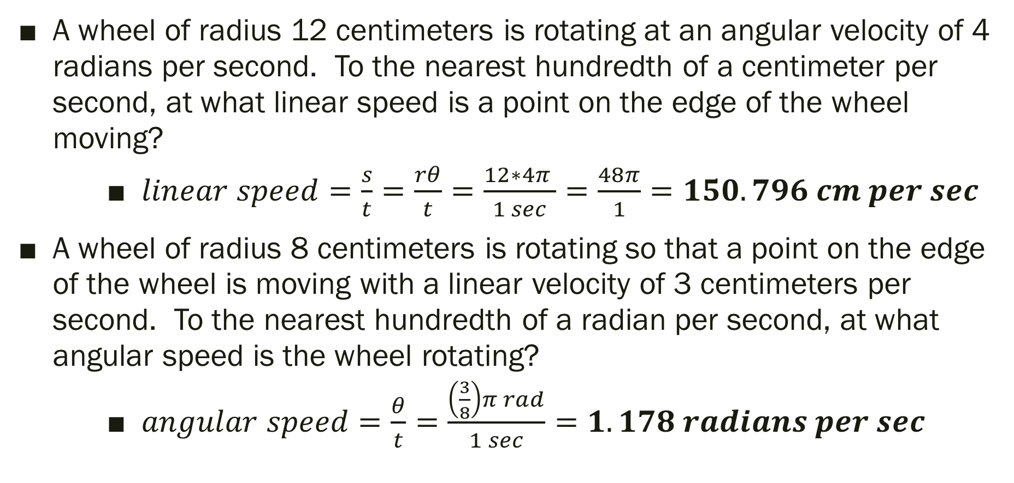
“Practice Test” Level 3 SOLUTIONS
A wheel of radius 12 centimeters is rotating at an angular velocity of 4 radians per second. To the nearest hundredth of a centimeter per second, at what linear speed is a point on the edge of the wheel moving?
$linear speed=\frac{s}{t}=\frac{rθ}{t}=\frac{12∗4π }{1 sec}=\frac{48π}{1}=150.796 cm per sec$
A wheel of radius 8 centimeters is rotating so that a point on the edge of the wheel is moving with a linear velocity of 3 centimeters per second. To the nearest hundredth of a radian per second, at what angular speed is the wheel rotating?
$angular speed=\frac{θ}{t}=\frac{\left(\frac{3}{8}\right)π rad}{1 sec}=1.178 radians per sec$

Slide 13
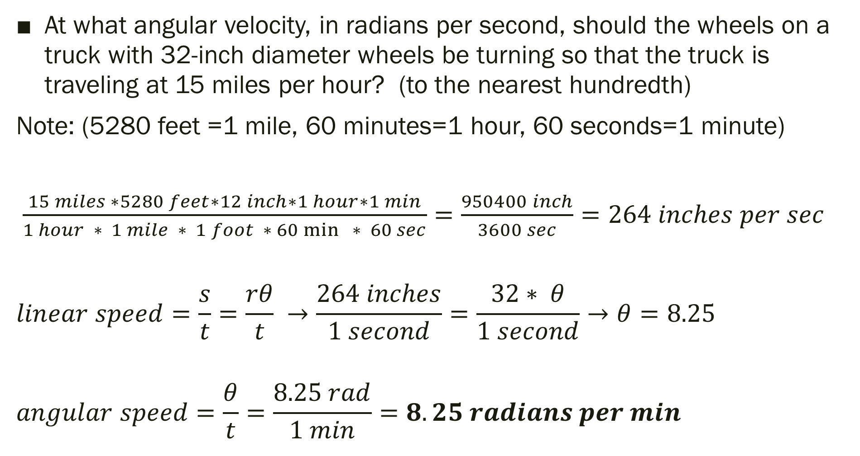
“Practice Test” Level 4 SOLUTIONS
At what angular velocity, in radians per second, should the wheels on a truck with 32-inch diameter wheels be turning so that the truck is traveling at 15 miles per hour? (to the nearest hundredth)
Note: (5280 feet =1 mile, 60 minutes=1 hour, 60 seconds=1 minute)
$\frac{15 miles ∗5280 feet∗12 inch∗1 hour∗1 min}{1 hour ∗ 1 mile ∗ 1 foot ∗ 60\min{ }∗ 60 sec}=\frac{950400 inch}{3600 sec}=264 inches per sec$
$$linear speed=\frac{s}{t}=\frac{rθ}{t} →\frac{264 inches}{1 second}=\frac{32∗ θ}{1 second}→θ=8.25$$
$$angular speed=\frac{θ}{t}=\frac{8.25 rad}{1 min}=8.25 radians per min$$

